Slide 1

BETA-IATEFL Bulgaria and
ECML Projects
BETA-IATEFL Bulgarien
und
EFSZ-Projekte
Sylvia Velikova
University of Veliko Turnovo
Bulgarian English Teachers’ Association (BETA-IATEFL)

Slide 2



AFFILIATION
IATEFL, UK
South Eastern Europe Teachers’ Associations (SEETA)
FIPLV (Fédération internationale des professeurs de langues vivantes)

Slide 3
MISSION
BETA seeks to build a network of ELT professionals on a national and regional (Southeastern Europe) level and establish the association as a recognised mediator between educators, state bodies, public and other organisations.

Slide 4
BETA-IATEFL members are
ELT professionals from all educational sectors in Bulgaria – primary, secondary and tertiary, both state and private
EFL Teachers
Teacher trainers and teacher educators
FL Experts of the Ministry of Education
Student teachers of English

Slide 5
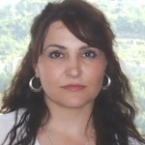
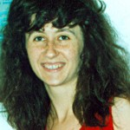
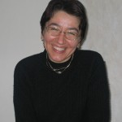
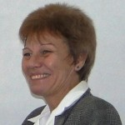
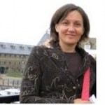
Committee Members (2010-2014)
President
Sylvia Velikova
University of Veliko Turnovo
Membership Secretary
Zhivka Ilieva
Dobrich College,
University of Shumen
Committee Member
Zarina Markova
South-West University of
Blagoevgrad
Committee Member
Ophelia Pamukchieva
Secondary School of Tourism, Sofia
Co-opted Member
Tanya Spahiyska
Freelance Teacher of English, Sofia
Newsletter Editor (co-opted member)
Tsvetelina Harakchiyska
University of Ruse

Slide 6

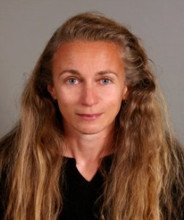
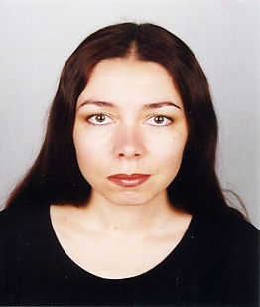
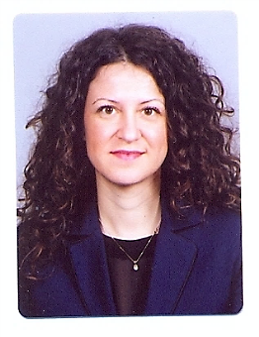
Committee Members (2014-2018)
President
Zhivka Ilieva
Dobrich College
University of Shumen
Membership Secretary
Albena Stefanova
University of National and World Economy, Sofia
Treasurer
Irina Ivanova
University of Shumen
Committee Member
Ophelia Pamukchieva
Secondary School of Tourism, Sofia
Newsletter Editors (co-opted members)
Zarina Marikova
South-West University of Blagoevgrad
Sylvia Velikova
University of Veliko Turnovo
Committee Member
Gergana Georgieva
South-West University of Blagoevgrad

Slide 7
Activities

Slide 8
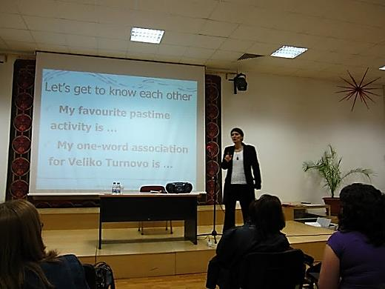
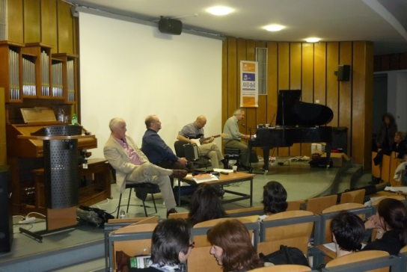
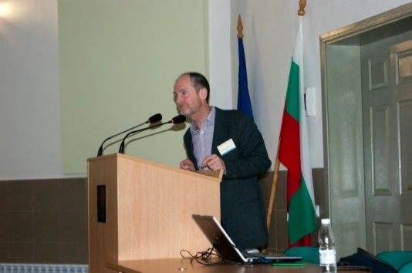
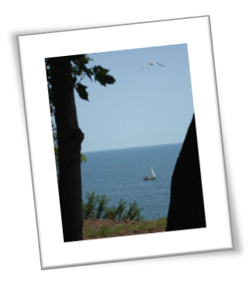
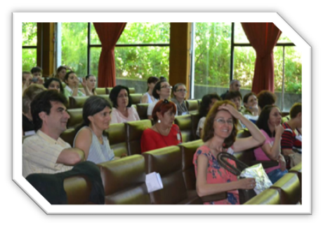
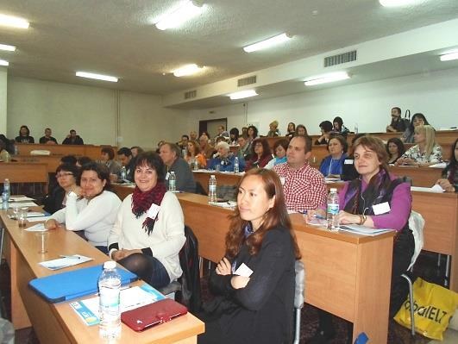
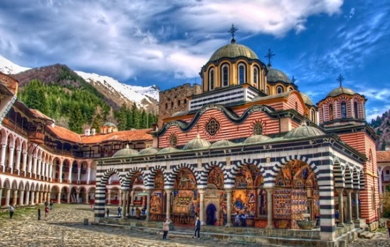
ANNUAL CONFERENCES
Veliko Turnovo 2010
Sofia 2011
Ruse 2012
Blagoevgrad 2014
Varna 2013

Slide 9
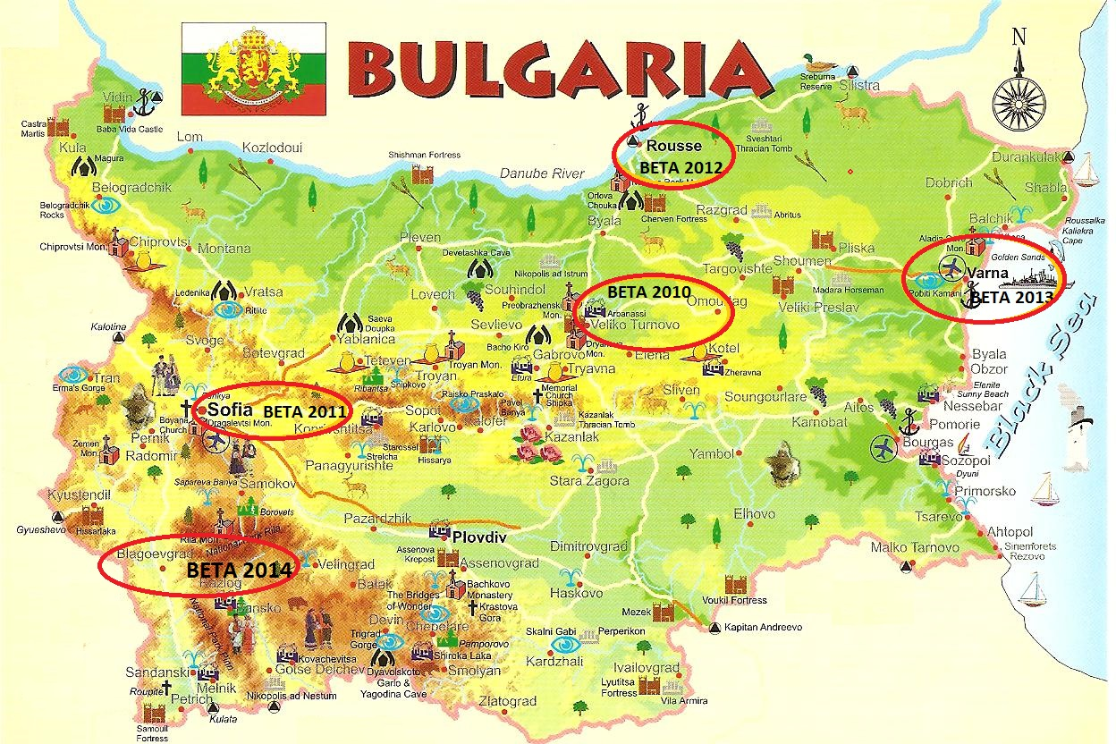

Slide 10
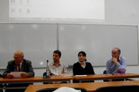
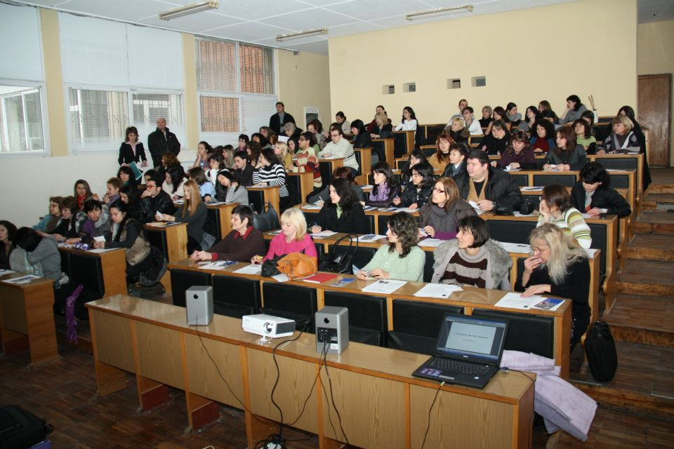
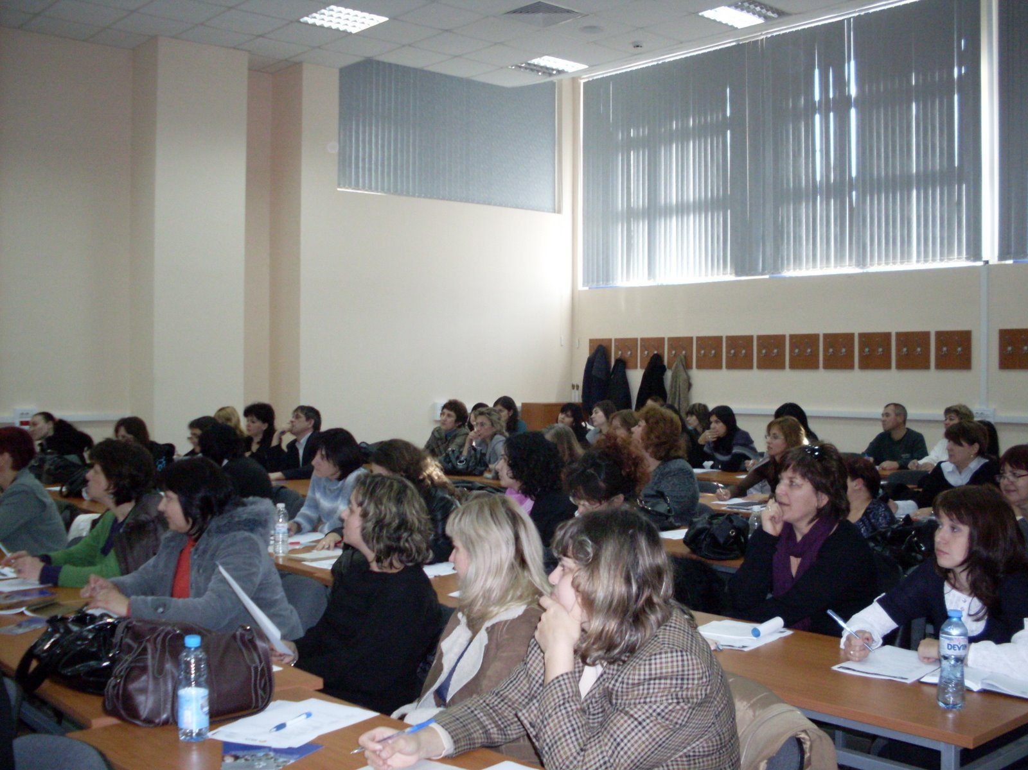
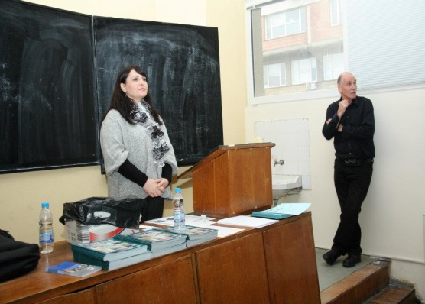
LOCAL EVENTS
Ruse, 2011
Veliko Turnovo, 2009 & 2012

Slide 11

INFORMATION DISSEMINATION
Find us at www.beta-iatefl.org
beta.iateflbg@gmail.com
https://www.facebook.com/groups/beta.iateflbg

Slide 12
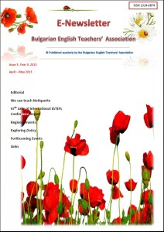
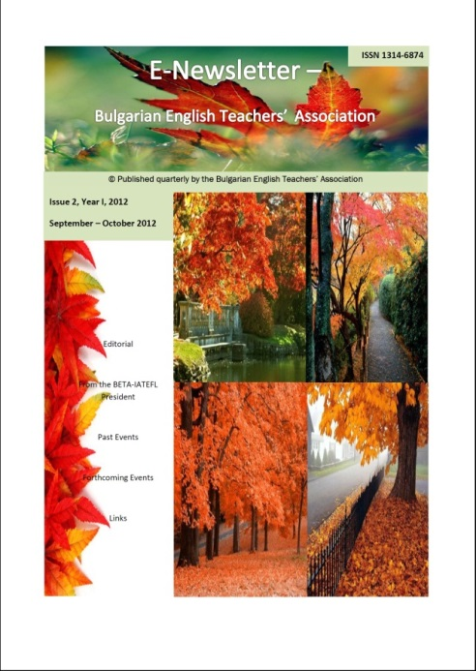
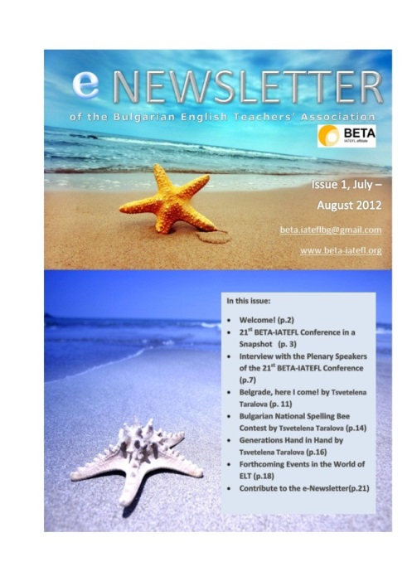
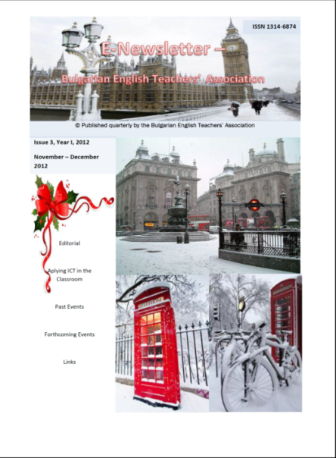
E-NEWSLETTER

Slide 13
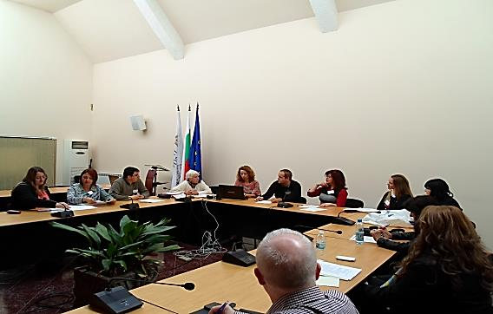
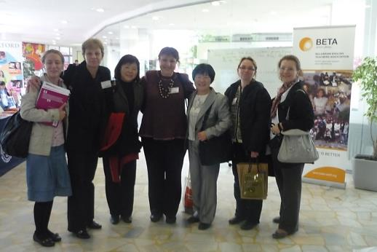
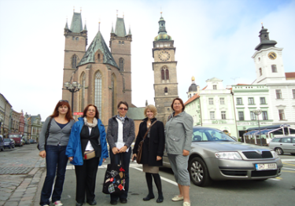
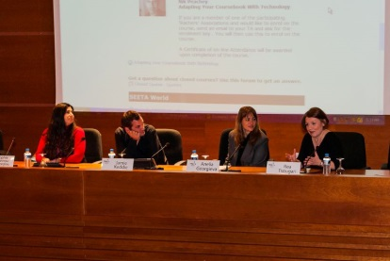
NETWORKING WITH TEACHERS’ ASSOCIATIONS
1st SEETA AGM at BETA 2014
BETA partners at the annual conference
ATECR-Czech Republic, ELTA Serbia, ELTAM-Macedonia, IATEFL-Poland, INGED-Turkey, TESOL-Hungary, TESOL-MTh Northern Greece
BETA at partners’ events (ATECR 2012 & TESOL MTh Northern Greece 2012)

Slide 14
DISSEMINATING ECML PROJECTS AND ACTIVITIES
(Programmes 2008-2011 and 2012-2015)
EPOSTL2: Piloting and Implementing the EPOSTL (http://epostl2.ecml.at)
LACS: Language Associations and Collaborative Support (http://lacs.ecml.at/)

Slide 15
DISSEMINATION ACTIVITIES
Workshops and talks on the EPOSTL project and on the use of the EPOSTL at the BETA-IATEFL Annual International Conferences in 2008 and 2009
ECML National Support Event on Teachers as Lifelong Learners. The European Portfolio for Student Teachers of Languages (2010)

Slide 16


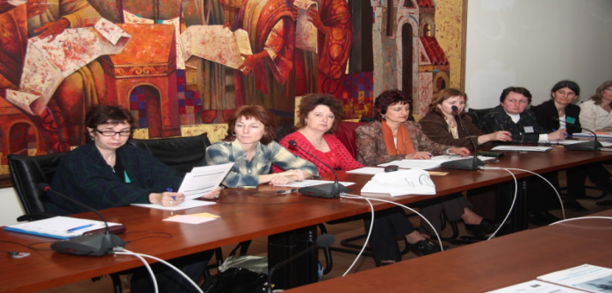
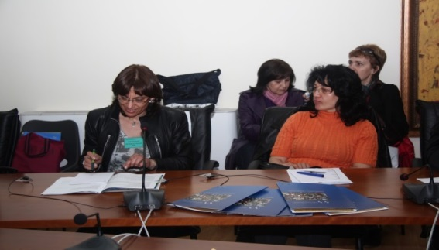
ECML NATIONAL SUPPORT EVENT
Teachers as Lifelong Learners. The European Portfolio for Student Teachers of Languages
Held as a Pre-Conference event of the BETA-IATEFL Annual International Conference in Veliko Turnovo, 2010
Attended by educators of various foreign languages
Included an exhibition of ECML publications and promotional materials

Slide 17
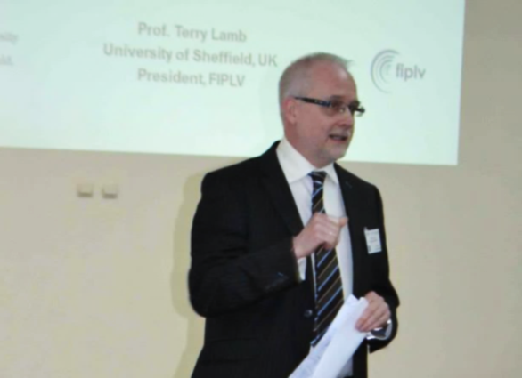
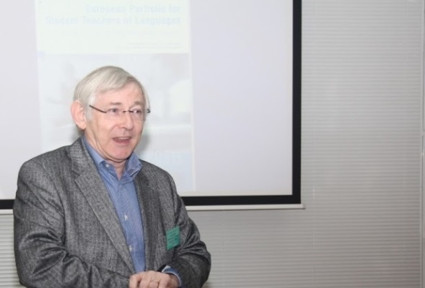
DISSEMINATION ACTIVITIES
Presentation of a book chapter on the EPOSTL at the BC Book Launch Event during the BETA-IATEFL Annual Conference in Varna, 2013
ECML experts and project leaders invited as plenary speakers at the BETA-IATEFL annual international conferences – David Newby (EPOSTL2) in 2010, Terry Lamb (LACS) in 2013 and 2014

Slide 18
DISSEMINATION ACTIVITIES
News and updates on the LACS project in the E-Newsletter (submitted by Nadezhda Doychinova, LACS project team member and BETA-IATEFL member)
Regular updates on the ECML activities on the BETA-IATEFL website, the E-Newsletter, and Facebook
Regular mailings with information about the ECML activities to BETA-IATEFL members

Slide 19
FURTHER IDEAS
TAs can disseminate ECML projects through:
Holding ECML book launch events or presentations/workshops by authors of ECML publications (book chapters, etc)
Organising local events and webinars for teachers with invited ECML experts / workshop participants
Encouraging and supporting action research projects (also collaboratively with partner TAs, e.g. within the SEETA community)
Organising competitions on subjects related to ECML projects (designing a lesson, course, teacher training workshop, poster, etc.)

Slide 20

beta.iateflbg@gmail.com
sylvia.velikova@gmail.com

